Slide 1
TRPG BATTLE ROYALE
Levi Pole

Slide 2
MOTIVATION
Games are fun
Something different
Learning Unity and game development
I think it’s a cool idea with potential

Slide 3
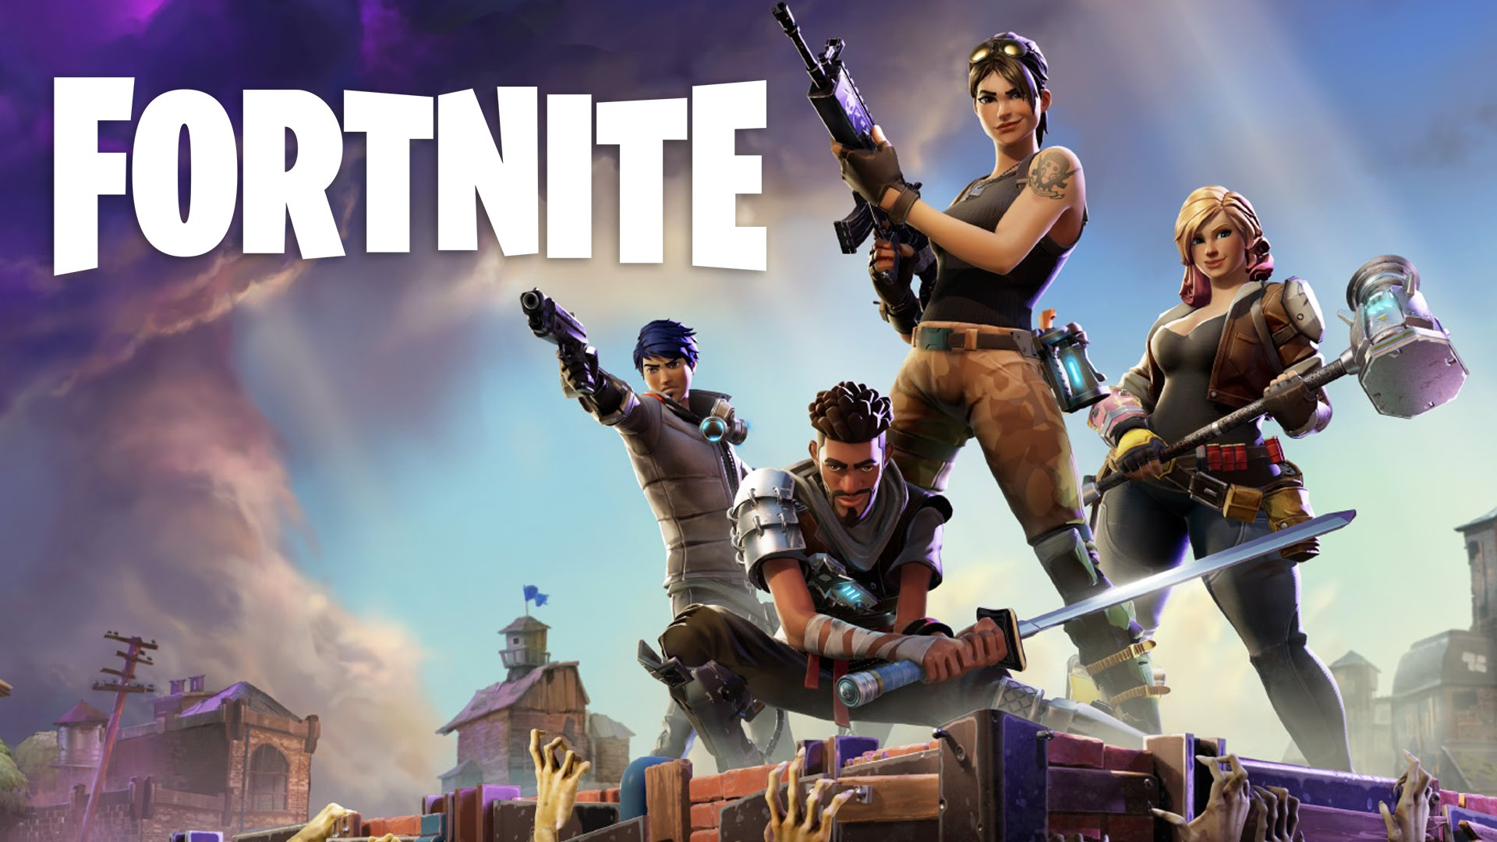
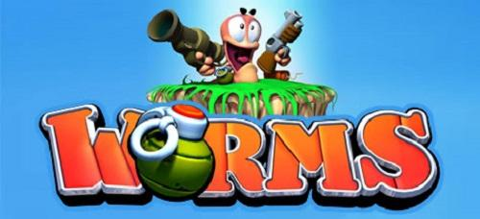
PROPOSAL
To develop a game that is a fusion of Battle Royales and TRPGs.
Example: Fortnite + Worms
Concepts are up for change

Slide 4
APP FEATURES
An enjoyable game
Access to Leaderboards
Weekly Rewards
Tutorial for new players
Competitive matchmaking
Social Aspect and playing with friends

Slide 5
PHONE REQUIRMENTS
Internet Access
Read and Write Data

Slide 6
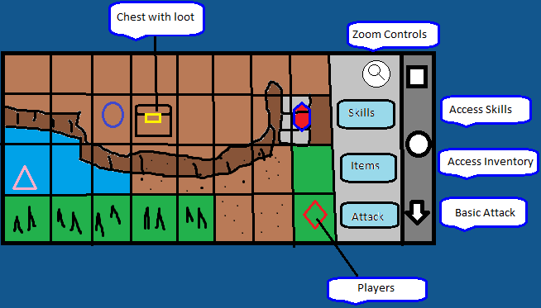
MOCKUP
Elevation Mechanics
Terrain effects on players
Loot in some way
Zoom controls
Different attacks and abilities

Slide 7
PROJECT TIMELINE
Within 6 weeks:
Week 1: Learn Unity and finalize ideas.
Week 2: Create the map, player, movement, player interaction.
Week 3: Work on gameplay, battle system, physics.
Week 4: Implement matchmaking, leaderboards, player stats.
Week 5: Implement remaining features, any remaining work.
Week 6: Polish assets and gameplay.

Slide 8
ANTICIPATED DELIVERABLES
A fully functional game
Functioning leaderboard system
Weekly rewards
Player stats

